Slide 1

Master Data Services in
SQL Server 2012
Mark Gschwind

Slide 2
Agenda
What is Master Data?
Why is it important?
Overview of SQL 2012 MDS
  Capabilities
  Underlying Architecture
Demo
  Creating a model
  Using the new Excel interface
  Creating a hierarchy
  Exposing MDS data to the DW
  Using business rules
Case Study
Tips on successful implementations
Notes:
How many people are using MDS ? How many people are using something else for MDM ?
Need to start w a little background…
Then some tips from my experience and from the program managers at MSFT

Slide 3



Mark Gschwind
Independent Consultant
Business Intelligence practitioner, manager since 1995
Over 50 Business BI projects
  Data Warehousing/Cubing/Reporting/Data Mining/EIM
MCP, certified in Oracle Essbase, Melissa Data MVP
Working with clients on EIM since 2008
mark@gschwindconsulting.com
find me on
www.linkedin.com/in/markgschwind
Blog Site:
www.marksbiblog.com
Notes:
Working w these EIM technologies for 5 years, 7 implementations

Slide 4
What is Master Data?
  Master Data is the set of data objects that are at the center of business activities (Customers, Products, Cost Centers, Locations…) requiring
      Centralized maintenance (or curation)
      Continuous quality management
      Ease of access for business users (not just IT)
      Effective sharing (producing and consuming)
  Master Data contains different attributes for different departments (marketing, finance, operations, business groups…)
MDS enables users to curate Master Data. This capability can be powerful in a number of scenarios across an organization.
Notes:
…most of us know what master data is, but stating some things about it will help frame our discussion about it.
Because of its importance, it can be in the center of many business processes and hence must be effectively shared for both producing and consuming
What MDS does is enable these different groups bring their objects together and they can be cared for centrally
Once an organization has this, it can be used in a number of scenarios

Slide 5


Main Scenarios
Data Management Solutions
Data Warehouse/ Data Marts Mgmt
Provides storage and management of the objects and metadata used as the application knowledge
Object mappings
Reference Data / managed object lists
Metadata management / data dictionary
Enable business users to manage the dimensions and hierarchies of DW / Data Marts
BI scenarios
The IT department has built a data warehouse and reporting platform, but business users need more agility in making updates.
MDS empowers the business users to manage dimensions themselves while IT can govern the changes
Table containing information on mapping objects between different systems. ETL processes are referencing the table making transformation decisions.
MDS enables business users to manage the objects mapping
Canonical form |  |  |  | System A |  |  | System B
Product ID | Product Name | Color | Size | ID | Name | Price | ID | Name
Notes:
Once an organization has this, it can be used in a number of scenarios
Data Warehouse
Allow users to change hierarchies without IT intervention
But IT wants to put some constraints and process around the data to enforce integrity
Enhance data quality by showing users exceptions, creating managed workflows
Data Management (Operational MDM)
Central customer database, merging multiple regional dBs
Push it to their downstream systems.
Use MDS to store metadata information about existing systems, tables, columns, repositories …. their meanings

Slide 6
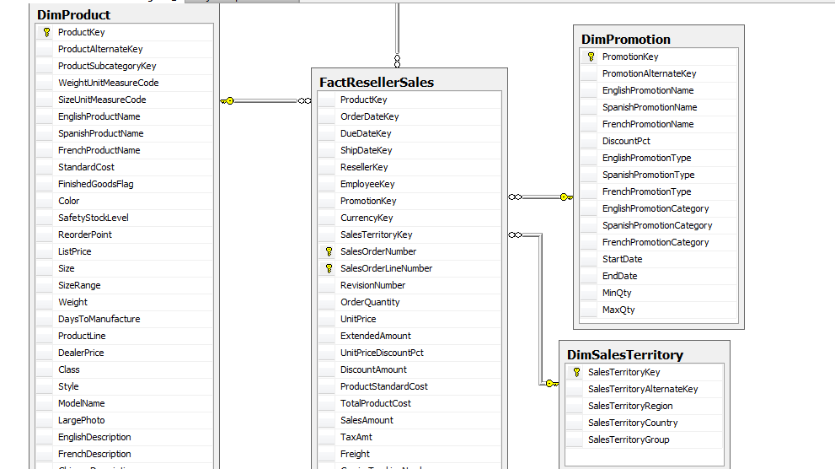
Where is Master Data (in a DW)?
Here
Here
Here
Notes:
Explaining by saying where it ends up

Slide 7
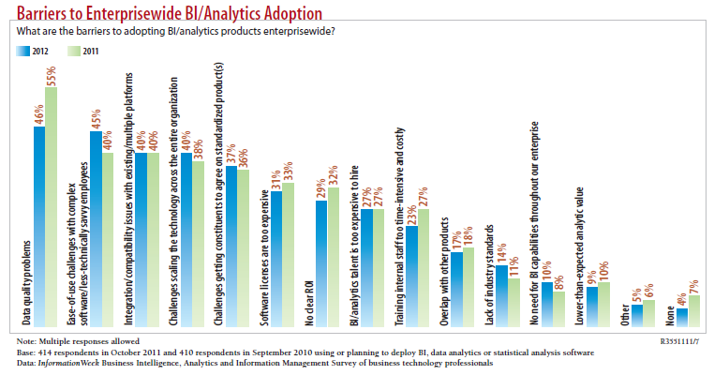

Why Master Data Is Important
Notes:
http://reports.informationweek.com/cart/index/downloadasset/id/8574

Slide 8
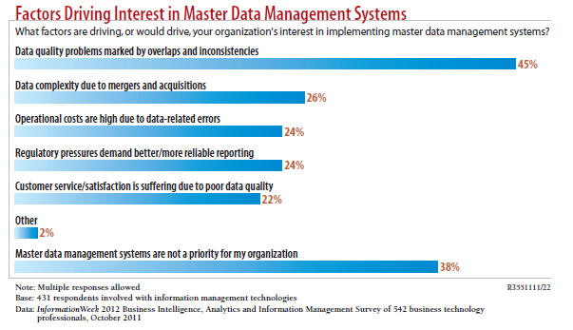
Why Master Data Is Important
Notes:
Clarify that to achieve Data Quality one needs:
Business Processes and Data Stewardship in addition to Technology
…MDS+DQS cover the technology piece

Slide 9
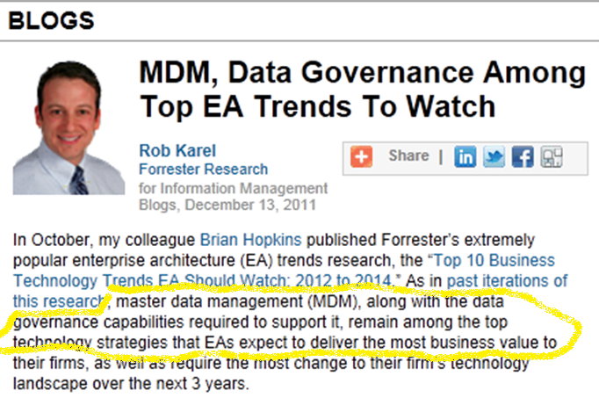
Why Master Data Is Important
Notes:
http://www.information-management.com/blogs/MDM-data-governance-enterprise-architecture-Karel-10021647-1.html?ET=informationmgmt:e2796:2062711a:&st=email&utm_source=editorial&utm
Not surprising to me, as I see data governance challenges as a major risk factor as well

Slide 10
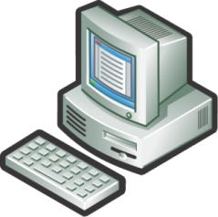







MDS Capabilities
Modeling
Entities, Attributes, Hierarchies
Validation
Authoring business rules to ensure data correctness
Master Data Stewardship
Data Matching
(DQS Integrated)
Role-based Security and Transaction Annotation
Excel Add-In
Web UI
Versioning
Enabling Integration & Sharing
Loading batched data through Staging Tables
Registering to changes through APIs
Consuming data through Views
Workflow / Notifications
Excel
DWH
External
(CRM, ..)
Notes:
Let’s talk about MDS’s capabilities for addressing these data quality challenges
In the center we have our data steward who uses the MDS web UI and Excel addin to continuously maintain data quality
Modelling an enterprise’s master data objects is a capability brought to the data stewardship process, as well as…
DQS – some integration, won’t be showing tonight
Data Quality Services is acquired from Zoomix in 2008
MDS is acquired from Stratature in 2007

Slide 11
MDS Architecture
Notes:
Now let’s talk about the underlying technologies supporting these capabilities
A requirement for any MDM system these days is it has to be SOAP-enabled, to interact with ERPs like SAP and Oracle.
The Windows Communication Foundation (or WCF), is an application programming interface (API) in the .NET Framework for building connected, service-oriented applications.
The Excel addin communicates through WCF, the Web UI uses Silverlight 5 (new in 2012 and enhances the performance)
BizTalk allows organizations to more easily connect disparate systems with over 25 multi-platform adapters and a robust messaging infrastructure.
External systems can interact w MDS either through the WCF to the MDS service, or more directly with SQL tables
Mention the database can be sql 2008 or sql 2012

Slide 12
Demo
Notes:
Any questions before I get into the demo ?

Slide 13
Business Rules
Business Rules are expressions and actions that can govern the conduct of business processes
Enable data governance by:
  -- Enforcing data standards
  -- Alerting users to data quality issues
  -- Creating simple workflows
Have limitations, but can be extended to SharePoint

Slide 14
Security
Functional area permissions
Model/Entity level permissions provide column-level security
Hierarchy permissions allow row-level security
Use AD groups, not individual users
Only use Hierarchy permissions if row-level security is required

Slide 15
Managing MDS Environments
Use MDS Configuration Manager to create a Dev website and DB
Use web UI to deploy model structure only
Use MDSModelDeploy.exe to deploy model+data
  To package an existing model
    MDSModelDeploy createpackage -package “customer_en.pkg” -model "Customer" -service "MDS1“ -includedata
  To deploy an existing package
    MDSModelDeploy deploynew -package “customer_en.pkg” -model "Customer" -service "MDS2“
  To deploy an update
    MDSModelDeploy deployupdate –package “customer_en.pkg”–version “VERSION_1” -service "MDS2“
Notes:
Under System Administration->System->Deployment you can deploy structure only
Creating a separate dev environment has been helpful for me and my team.

Slide 16
Case Study
Notes:
Main point is need to figure out the people part

Slide 17
MDS Tips
Start small and build incrementally
Create and use a development environment
Engage the business users and get them to own the process
Notes:
It is easy to use, and I recommend trying it out and playing with it.
I think it will come in handy as you are implementing BI systems.

Slide 18
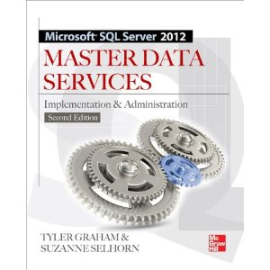
Additional Resources
Suzanne Selhorn’s site:
http://www.mdsuser.com/
MSDEV on YouTube
http://www.msdev.com/Directory/SeriesDescription.aspx?CourseId=155
MSDN:
http://msdn.microsoft.com/library/ee633763%28SQL.110%29.aspx
Forum:
http://social.msdn.microsoft.com/Forums/en/sqlmds/threads

Slide 19


SQL Saturday #144 After Party
Sponsored by at
Light food and drinks will be served!!
  6PM to ?
  1369 Garden Highway
  Sacramento, CA
  Phone: 916-649-0390

Slide 20
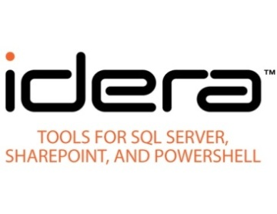

















Thank you to our Sponsors

