Slide 1
Hierarchies
Tyler Graham
Senior Program Manager
Master Data Services
Microsoft Corporation
Microsoft
SQL Server 2012
®
®

Slide 2
Agenda
Introduction to Hierarchies
Level Based vs. Ragged Hierarchies
Derived Hierarchies
Complex Hierarchies
Hierarchy Demo
Collections

Slide 3
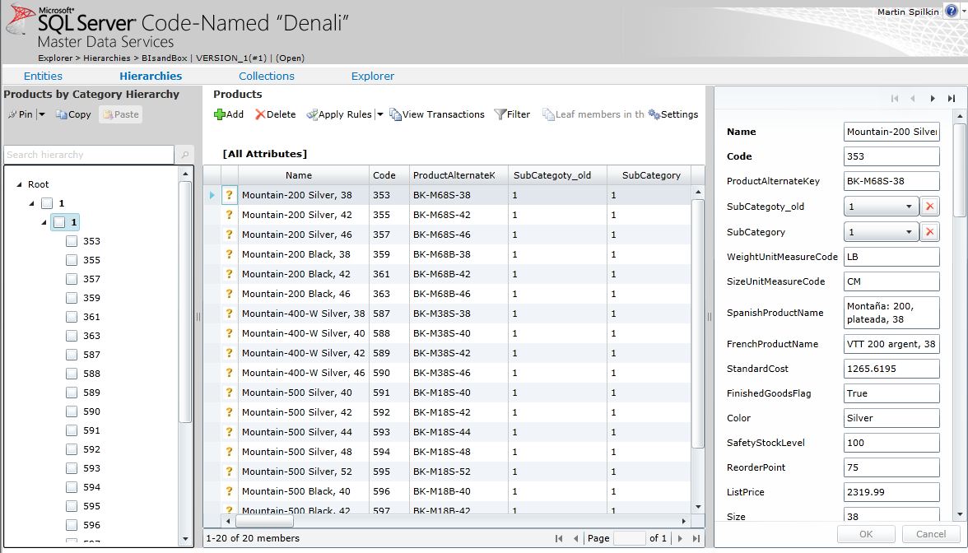
What is a hierarchy?
Hierarchies are logical tree structures that represent relationships between members.
Used in Financial Reporting
Every Member has only one parent member.

Slide 4
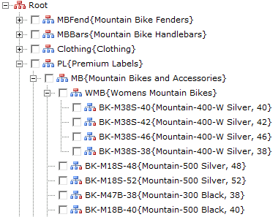
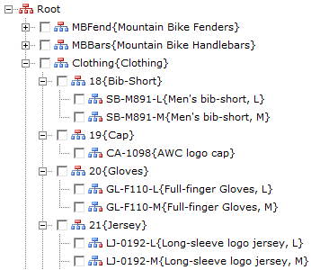
Level Based vs. Ragged Hierarchies
Level Based Hierarchies require all leaf members at the same level
Ragged Hierarchies support leaf members at multiple levels of the hierarchy
Explicit Hierarchy
Derived Hierarchy

Slide 5
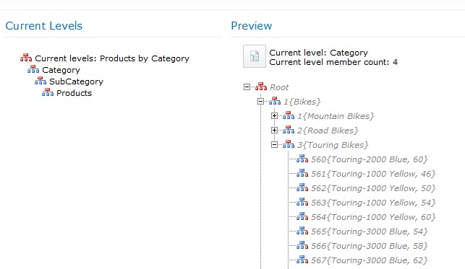
Derived Hierarchies
Allow for the automatic and accurate creation of hierarchy paths based on attribute relationships
Display Attributes in different entities in a hierarchical way
Viewed and maintained either by changing the attribute values or the hierarchy tree structure in the Hierarchy Explorer
This Entity is domain-based attribute in Entity bellow it
This a member in the Subcategory Entity
These are members in the Product Entity

Slide 6
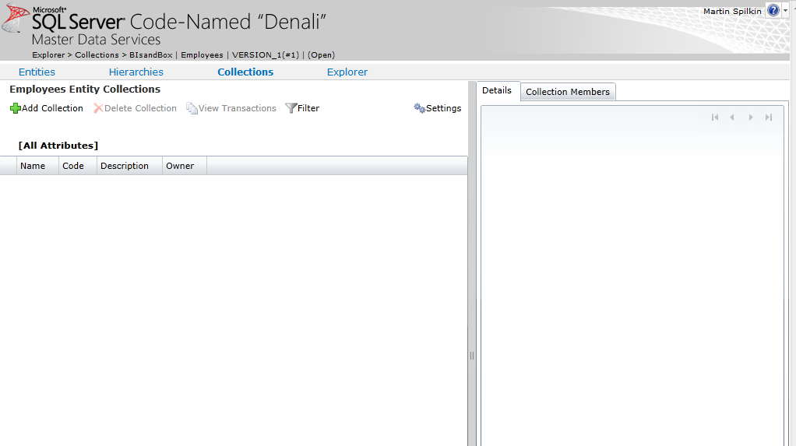
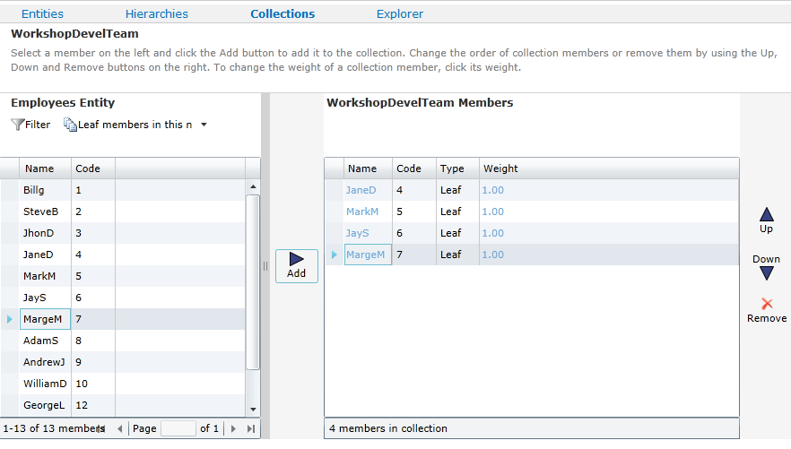
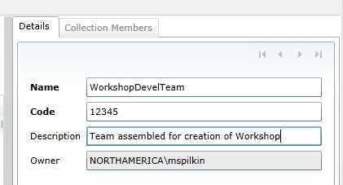
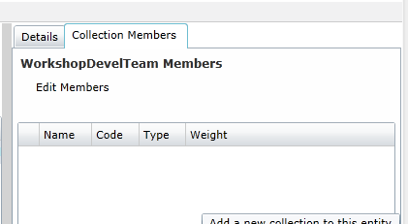
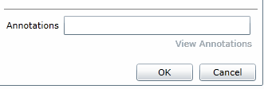
What is a Collection?
Allows grouping of members
Can hold leaf or consolidated members from a single Entity

Slide 7
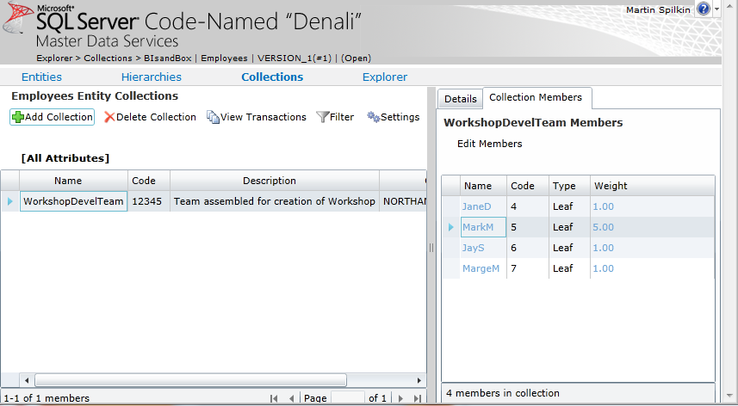
Weighting of Collection Members
Weighting is an additional attribute added to collection members
Useful for managing ratios within the collection members

Slide 8
© 2011 Microsoft Corporation. All rights reserved. Microsoft, Windows, Windows Vista and other product names are or may be registered trademarks and/or trademarks in the U.S. and/or other countries.
The information herein is for informational purposes only and represents the current view of Microsoft Corporation as of the date of this presentation. Because Microsoft must respond to changing market conditions, it should not be interpreted to be a commitment on the part of Microsoft, and Microsoft cannot guarantee the accuracy of any information provided after the date of this presentation. MICROSOFT MAKES NO WARRANTIES, EXPRESS, IMPLIED OR STATUTORY, AS TO THE INFORMATION IN THIS PRESENTATION.

