Slide 1
MDS Security
Andi Comisioneru
Principal Group Program Manager
Microsoft Corporation
Microsoft
SQL Server 2012
®
®

Slide 2
Agenda
Who is Secured
What is Secured
Logic and the Effective Permissions
Guidelines and Best Practices

Slide 3
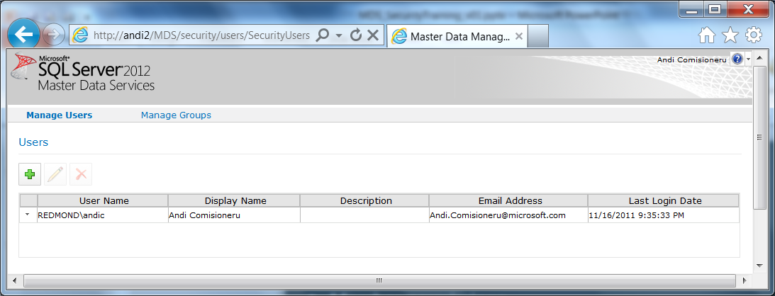
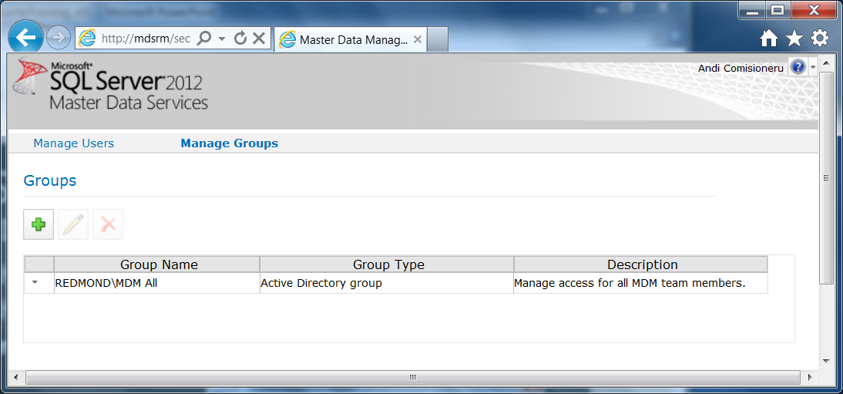
Who is MDS Securing?
User and Group: Integrated with Active Directory
Group membership is defined in AD
Group membership is inherited through AD
Users are authenticated via AD and authorized via MDS
Manage user accounts
Add and remove users
View and update user information
Maintain user permission assignments to functions, models and hierarchy members
Manage user groups
Add and remove groups
Maintain group permission assignments to functions, models and hierarchy members
(Users will automatically show added on their 1st access to MDS)

Slide 4
What is MDS Securing?
Explorer (Web+
Excel-Add In)
System Administration
Integration Management
Permissions to Functions
(Role Based Permissions)
Version Management
User and Group Permissions
Permissions to Model Objects
Model
Entities
Hierarchy
Permissions to Hierarchy Members
Member Type
Leaf
Consolidated
Collections
Hierarchy Member 1
Model Security
Collections
Hierarchy Member 2
 | DBA
Hierarchy Member n
Members
Hierarchy
Security
4

Slide 5
Security Provisioning in MDS
Pre-req: users, groups and membership defined in AD
Add users and groups to MDS
Assign access to functions
Optional
Assign access to model components
Assign access to members
Edit user email profile
Access levels

Slide 6
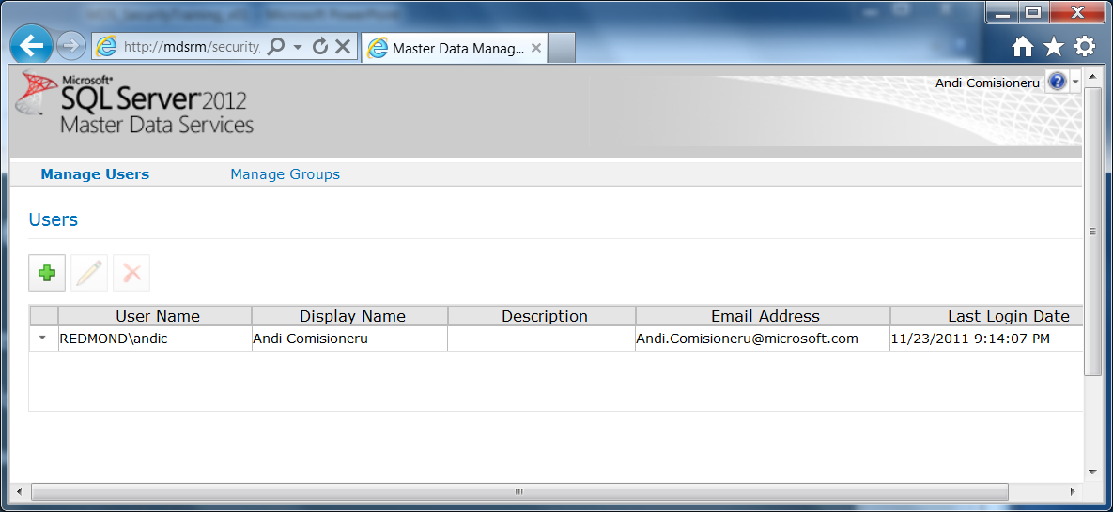
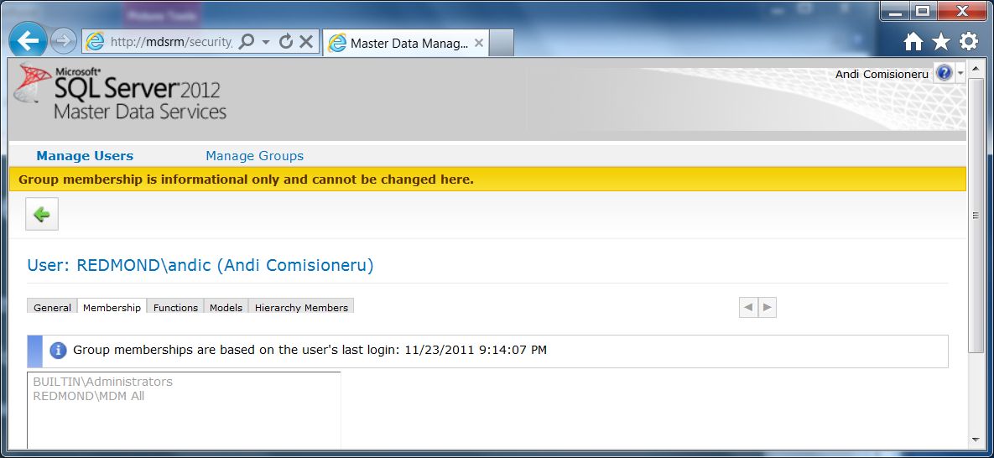
Manage Users
Properties
Email format maintained in MDS
Email address maintained in MDS if a local user
Last Login Date updated by MDS
All other properties inherited from AD
Active Directory
MDS
Membership
Indicates groups to which the user belongs
Read-only – inherited from AD

Slide 7
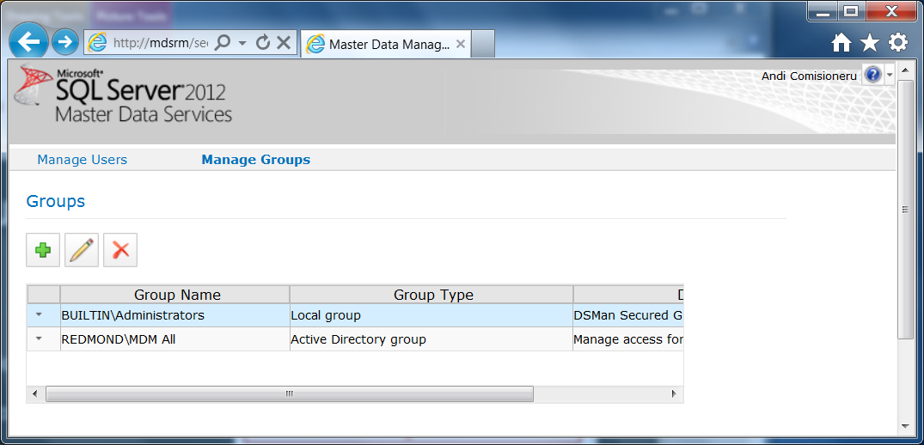
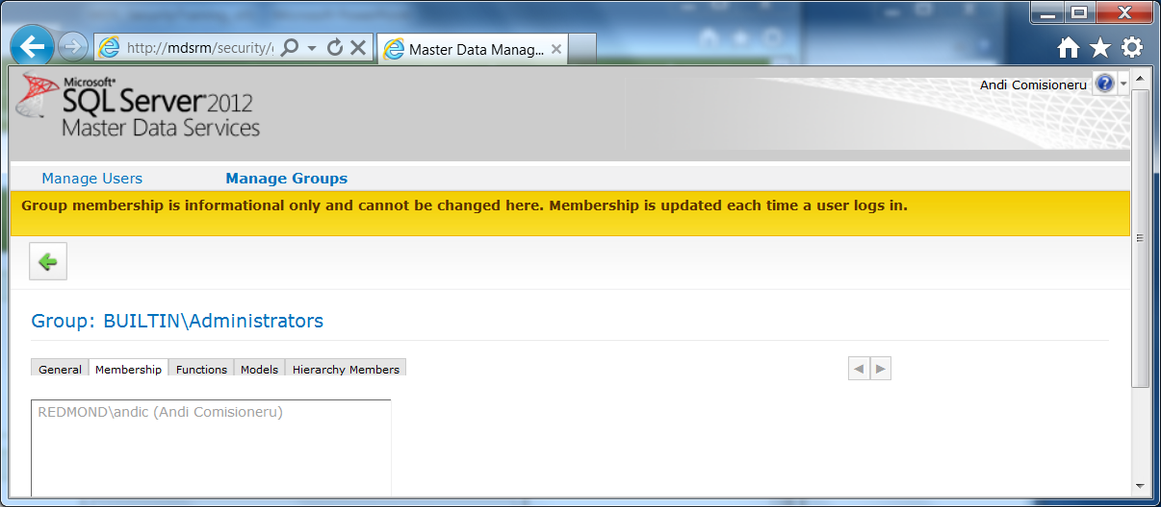
Manage Groups
Properties
General group information
Read-only – inherited from Active Directory
Group types
LocalGroup
ActiveDirectoryGroup
Active Directory
Membership
Indicates users associated with selected group
Read-only – inherited from AD

Slide 8
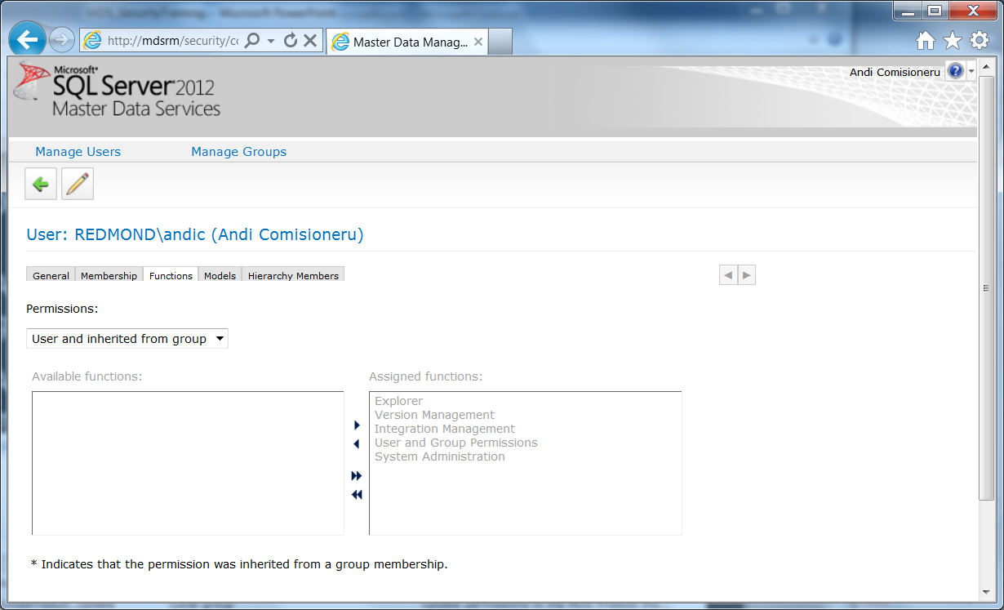
Function Permissions
Role based permissions
Assign access to one or more functions to a user or group

Slide 9
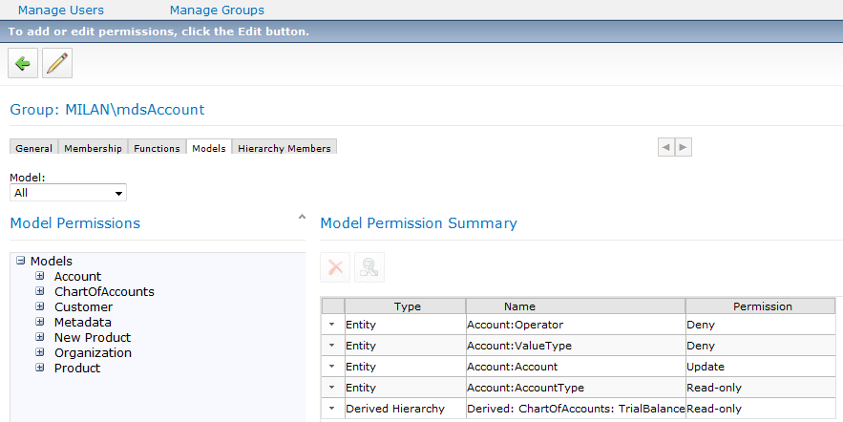
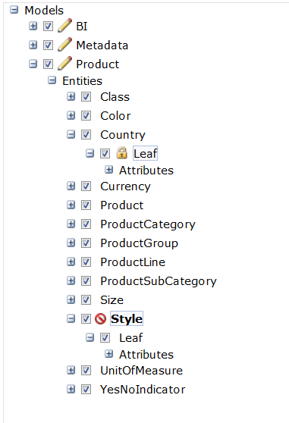
Model Permissions
Attributes (Column) based permissions
Selected group
Restrict assignments to a model
Access location of selected security assignment
Lists all security assignments for the selected model

Slide 10
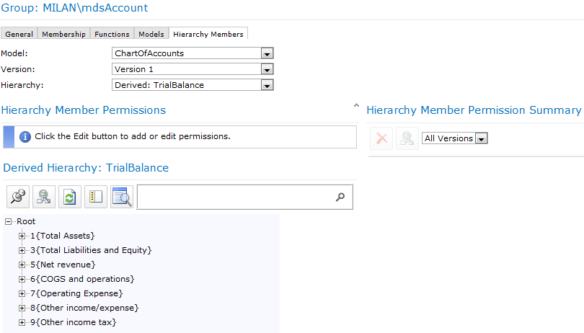
Hierarchy Members Permissions
Assign member security for the selected version and hierarchy
Hierarchy (Row) Based Permissions
Member security assignments for the selected group
Members associated with the selected hierarchy

Slide 11
Effective Permissions
Model Object Inheritance
Hierarchy Member Inheritance
Group / User Combination
for Model Security
Group / User Combination
for Member Security
Calculated from
Inheritance: from a parent model object or member
Group Association
Intersection of model and member security
Model / Member Intersection
Order of Operations
Hierarchical inheritance is applied
Permissions cascade down the hierarchy unless overwritten at a lower level
Security roles are combined across the user’s groups and the direct user permissions
Group1 perms + … + Group N perms + User perms = User’s effective permissions
Intersect model and hierarchy member security
Model permission and Member permission = Data element permission
Special cases:
Read or Update can’t override a higher level Deny (You can’t change what you can’t see)
Code and Name cannot be explicitly denied

Slide 12
Members Security
Assigned permissions are inherited and cascade down the hierarchy from the closest ancestor
For overlapping hierarchies, the most restrictive permission wins; order of succession is as follows:
Deny
Read-only
Update
Unspecified
For overlapping groups permissions, the least restrictive permission wins
Examples
UpdateGroup1 + ReadGroup2 = UpdateUser’s Effective
DenyGroup1 + UpdateGroup2 = DenyUser’s Effective
UpdateGroup1 + ReadGroup2 + DenyUser = DenyUser’s Effective

Slide 13
Guidelines / Recommended Practices
Keep it simple
Outline the multiple roles and responsibilities to drive security req
Derive req for function, model and member security
Use Member security sensibly (single hierarchy recommended)
Keep it Minimal
Security function is typically reserved for a single system administrator
Typical end-user will be granted permission to the Explorer function only
Keep It Generic
Assign permissions to group security rather than users
User roles change over time
Easier to manage through lifecycle (layer of indirection)
Always review the resultant effective permissions

Slide 14
© 2011 Microsoft Corporation. All rights reserved. Microsoft, Windows, Windows Vista and other product names are or may be registered trademarks and/or trademarks in the U.S. and/or other countries.
The information herein is for informational purposes only and represents the current view of Microsoft Corporation as of the date of this presentation. Because Microsoft must respond to changing market conditions, it should not be interpreted to be a commitment on the part of Microsoft, and Microsoft cannot guarantee the accuracy of any information provided after the date of this presentation. MICROSOFT MAKES NO WARRANTIES, EXPRESS, IMPLIED OR STATUTORY, AS TO THE INFORMATION IN THIS PRESENTATION.

